Slide 1
Module 2: Mandated Tasks of United Nations Peacekeeping Operations
Lesson
2.3
Protection of Human Rights

Slide 2
Relevance
Peacekeeping personnel must:
Recognize and respond to human rights violations/abuses
Protect and promote human rights
UN Core Pre-Deployment Training Materials 2017

Slide 3
Learning Outcomes
Learners will:
Identify human rights violations/abuses
Explain UN policies on human rights
Identify human rights-related roles in mission
Describe coordination role of human rights unit
List actions to take when human rights violations/ abuses are observed
UN Core Pre-Deployment Training Materials 2017

Slide 4
Lesson Overview
Definitions
Importance of Human Rights Protection
Legal Framework
UN Partners Leading in Human Rights
UN Policies on Human Rights
Human Rights in UN Peacekeeping
Roles & Responsibilities
What Individual Peacekeeping Personnel Can Do
UN Core Pre-Deployment Training Materials 2017

Slide 5
Learning Activity
2.3.1
Trauma of War
Instructions:
Consider the testimonies of civilians
Which human rights are at risk?
What is your responsibility as the UN?
Discuss “vulnerability”, “duty to protect” and “trust”
Time: 10-15 minutes
Group work: 5-7 minutes
Discussion: 5-7 minutes
UN Core Pre-Deployment Training Materials 2017

Slide 6
Learning Activity
2.3.2
Human Rights – Violations and Abuse
Instructions:
What is the difference between human rights violations and human rights abuses?
Give examples of human rights violations
Time: 10 minutes
Brainstorming: 5-7 minutes
Discussion: 3 minutes
UN Core Pre-Deployment Training Materials 2017

Slide 7
1. Definitions
Violations & Abuses
Human rights violation: action/inaction of state official or agent – police, soldier, judge, local administrator, parliamentarian
Human rights abuse: committed by non-state actors – rebel groups, corporations, individuals
UN Core Pre-Deployment Training Materials 2017

Slide 8
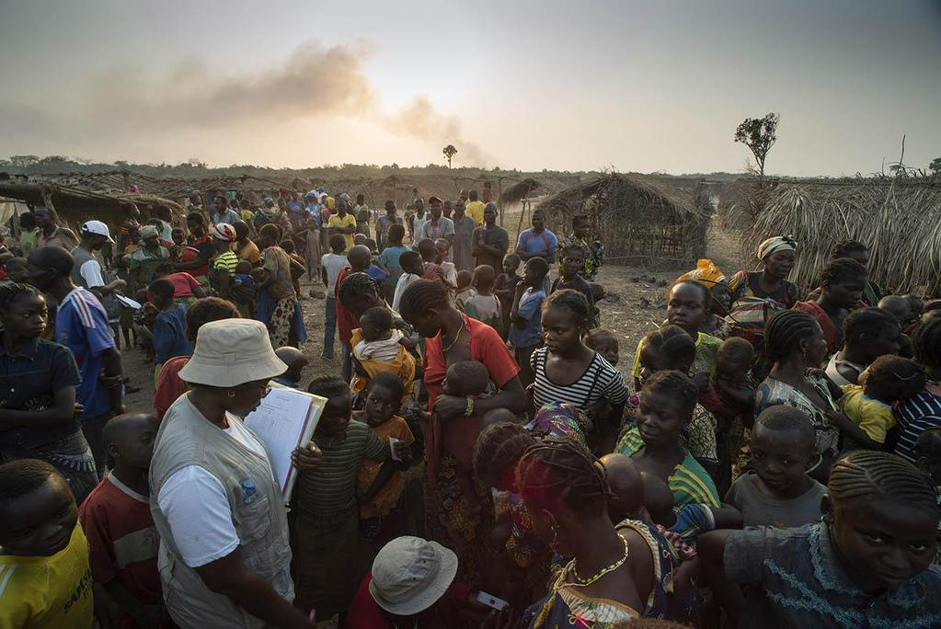
2. Importance of Human Rights Protection
Human rights – a core pillar of the UN
“We will not enjoy development without security, we will not enjoy security without development and we will not enjoy either without respect for human rights”
UN Core Pre-Deployment Training Materials 2017

Slide 9
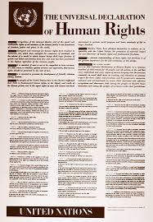
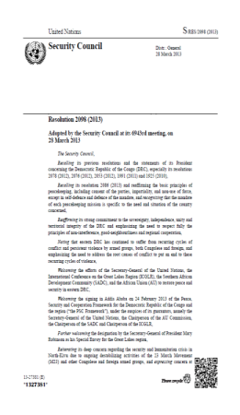
3. Legal Framework
UN Charter
International Human Rights Law
Security Council resolutions
UN Core Pre-Deployment Training Materials 2017

Slide 10
4. UN Partners Leading in Human Rights
Office of the High Commissioner for Human Rights (OHCHR)
UN Core Pre-Deployment Training Materials 2017

Slide 11
5. UN Policies on Human Rights
“Human Rights up Front” (HRuF) Initiative (2013)
UN Policy on Human Rights in UN Peace Operations and Political Missions (2011)
UN Policy on Human Rights Screening of UN Personnel (2012)
Human Rights Due Diligence Policy on UN Support to Non-UN Security Forces (2013)
UN Core Pre-Deployment Training Materials 2017

Slide 12
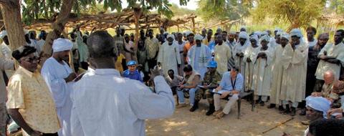
6. Human Rights in UN Peacekeeping
Integrate into every day work
Support national capacity
UN Core Pre-Deployment Training Materials 2017

Slide 13
7. Roles & Responsibilities
Human Rights Unit
Monitor and investigate human rights violations/abuses
Produce internal and public reports
Advocacy and intervention
Strengthen national/local capacity
Coordination and mainstreaming in PKO, UNCT and Humanitarian Country Team
Protection
Empowerment
Goal
UN Core Pre-Deployment Training Materials 2017

Slide 14
Other Units
Rule of Law/Justice
Corrections
Gender Adviser
Women Protection Adviser
Child Protection
Protection of Civilians
SSR
Civil Affairs
Electoral
DDR
Political Affairs
DSRSG/RC/HC
SRSG’s Office
UN Core Pre-Deployment Training Materials 2017

Slide 15
Special Roles of Police
Mentoring
Vetting, training and advising
Investigating
Reporting
Human Rights
UN Core Pre-Deployment Training Materials 2017

Slide 16
Special Roles of Military
Human Rights
Physical protection
Human rights monitoring and reporting
Supporting partners
UN Core Pre-Deployment Training Materials 2017

Slide 17
8. What Individual Peacekeeping
Personnel Can Do
Take note of facts
Immediately report
Protect sensitive information
Consult Human Rights component
Promote understanding – translators
Avoid false expectations – victims, witnesses
Appropriate intervention
Follow the situation
UN Core Pre-Deployment Training Materials 2017

Slide 18
Learning Activity
2.3.3
Essential Information to Record
Instructions:
Consider the testimonies of civilians
Document human rights violations and abuses
Record key information for investigation and follow-up
Time: 5 minutes
Brainstorming: 3 minutes
Discussion: 2 minutes
UN Core Pre-Deployment Training Materials 2017

Slide 19
Summary of Key Messages
Violations/abuses – state/non-state actors
UN policies on human rights – integrate into activities, screen UN personnel, compliance of non-UN security forces
All personnel play a role – coordination role of Human Rights component
Take action – report, coordinate, intervene
UN Core Pre-Deployment Training Materials 2017

Slide 20
Questions
UN Core Pre-Deployment Training Materials 2017

Slide 21
Learning Activity
Learning Evaluation
UN Core Pre-Deployment Training Materials 2017

